Slide 1
[ICML’18 Tutorial]
http://unsupervised.cs.princeton.edu/deeplearningtutorial.html
Toward Theoretical Understanding of Deep Learning
Sanjeev Arora Princeton University Institute for Advanced Study
http://www.cs.princeton.edu/~arora/
Group website: unsupervised.princeton.edu
@prfsanjeevarora
Support: NSF, ONR, Simons Foundation, Schmidt Foundation, Amazon Resarch, Mozilla Research. DARPA/SRC

Slide 2

Some History
1950s and 1960s: “Perceptron” (single-layer, 1 output node)
1969: Perceptrons are very limited [Minsky,Papert]
1990s-2010: Perceptron+ (namely, SVMs) strikes back. (Riding on convex optimization theory, generalization theory, expressivity theory of kernels, etc.).
Last 10 years: Age of deep learning (multilayer perceptron).
Theory??
?

Slide 3
Deep Learning: Terminology
θ: Parameters of deep net (x₁,y₁), (x₂,y₂),… iid (point, label) from distribution D (training data)
Loss function (how well net output matched true label y on point x) Can be l₂, cross-entropy….
Objective
Gradient Descent
Stochastic GD: Estimate ∇ via small sample of training data.
Notes:
\ell(\theta, x, y)
\text{argmin}_{\theta} E_{i}[\ell(\theta, x_i, y_i)]
\theta^{(t+1)} \leftarrow \theta^{(t)} -
\eta \nabla_{\theta}(E_{i}[\ell(\theta^{(t)}, x_i, y_i)])
Use Theta throughout…

Slide 4
Optimization concepts already shape deep learning
(together with GPUs, large datasets)
Backpropagation: Linear time algorithm to compute gradient.
“Gradient/landscape shaping” drives innovations such as resnets, wavenets, batch-normalization, …
Gradient Descent++ (Momentum, Regularization, AdaGrad,..) Came from convex world.
Goal of theory: Theorems that sort through/support competing intuitions, leading to new insights and concepts.

Slide 5

Talk overview
Optimization: When/how can it find decent solutions? Highly nonconvex.
Overparametrization/Generalization: # parameters ≫ training samples. Does it help? Why do nets generalize (predict well on unseen data)?
Role of depth?
Unsupervised learning/GANs
Simpler methods to replace deep learning? (Examples of Linearization from NLP, RL…)
Training error
Test error
Notes:
E_{i}[\ell(\theta, x_i, y_i)] \\
\\
E_{(x, y) \in \mathcal D}[\ell(\theta, x, y)]

Slide 6
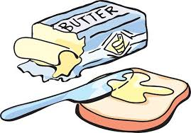
Part 1: Optimization in deep learning
Hurdle: Most optimization problems in deep learning are nonconvex, and on worst-case instances are NP-hard.
Notes:
Black/Nonblack
Local/global

Slide 7

Basic concepts
Note: ∇ ≠ 0 ➔ ∃ descent direction.
Possible goals: Find critical point (∇ =0). Find “local optimum”, ie bottom of some valley (∇² is psd/ ∇² ≽ 0) Find global optimum 𝛉*.
Assumption about initialization:
Convergence from all starting points 𝛉?
Random initial point? Special initial points?
Black box vs nonblack box
In R^{d}, want run times poly(d, 1/𝜀) where 𝜀= accuracy. (naive: exp(d/𝜀))

Slide 8
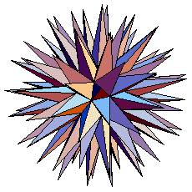
Curse of dimensionality
In R^{d}, ∃ exp(d) directions whose pairwise angle is > 60 degrees
∃ exp(d/ε) special directions s.t. all directions have angle at most ε with one of these (“ε-net”, “ε−cover”)
“Time to explore d-dimensional parameter space.” (INFEASIBLE)

Slide 9

Black box analysis for deep learning
Why: Don’t know the landscape, really
No clean math. characterization of (x_{i}, y_{i}) !
f(𝛉)
INFEASIBLE to find global optimum;
must settle for weaker soln concepts
𝛉
f
∇f|_{𝛉}
f = training error
[NB: Some attempts to understand landscape via statistical physics; not much success so far..]

Slide 10
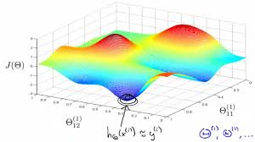
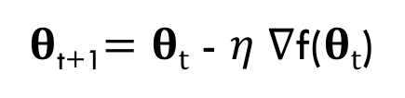
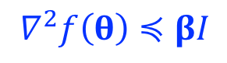
Gradient descent in unknown landscape.
𝛉_{t+1}$=θt$ - 𝜂 ∇f($θt$)
∇ ≠ 0 ➔ ∃ descent direction
But if 2nd derivative (∇²) high, allows ∇ to fluctuate a lot!
➔ To ensure descent, take small steps determined by smoothness
$$∇^{2}f\left(θ\right)≼βI$$
Can be assumed via gaussian smoothening of f.

Slide 11
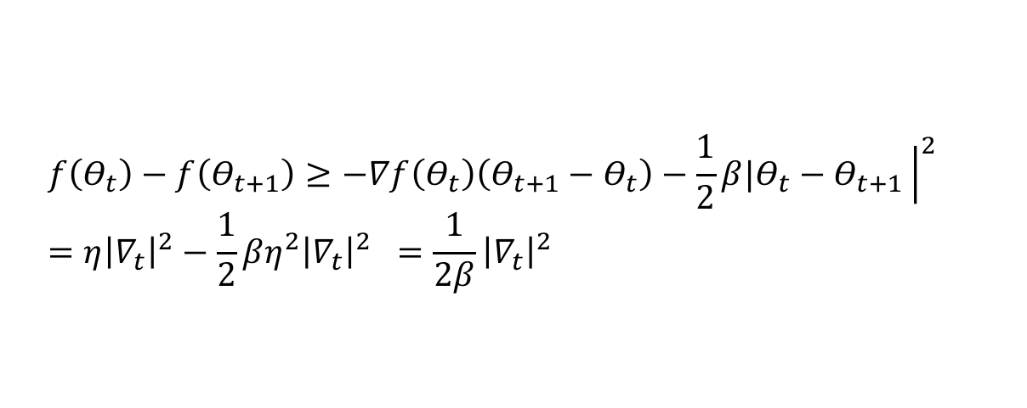
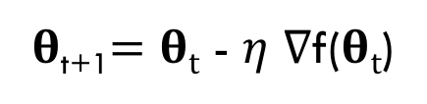
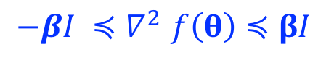
Gradient descent in unknown landscape (contd.)
𝛉_{t+1}$=θt$ - 𝜂 ∇f($θt$)
Smoothness
CLAIM: 𝜂 = 1/2𝛽 ⇒ achieve|∇f| < 𝜺 in #steps proportional to 𝛽/𝜺².
$$−βI {≼∇}^{2}f\left(θ\right)≼βI$$
$$f\left(Θ_{t}\right)−f\left(Θ_{t+1}\right)≥−∇f\left(Θ_{t}\right)\left(Θ_{t+1}−Θ_{t}\right)−\frac{1}{2}β|Θ_{t}−Θ_{t+1}{\left.​\right|}^{2} \\ =η{\left|∇_{t}\right|}^{2}−\frac{1}{2}βη^{2}{\left|∇_{t}\right|}^{2} =\frac{1}{2β}{\left|∇_{t}\right|}^{2}$$
Pf:
➜ update reduces function value by 𝜺²/2β
But critical point (∇f =0)
is a weak solution concept.

Slide 12
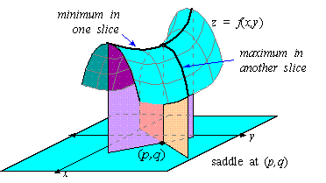
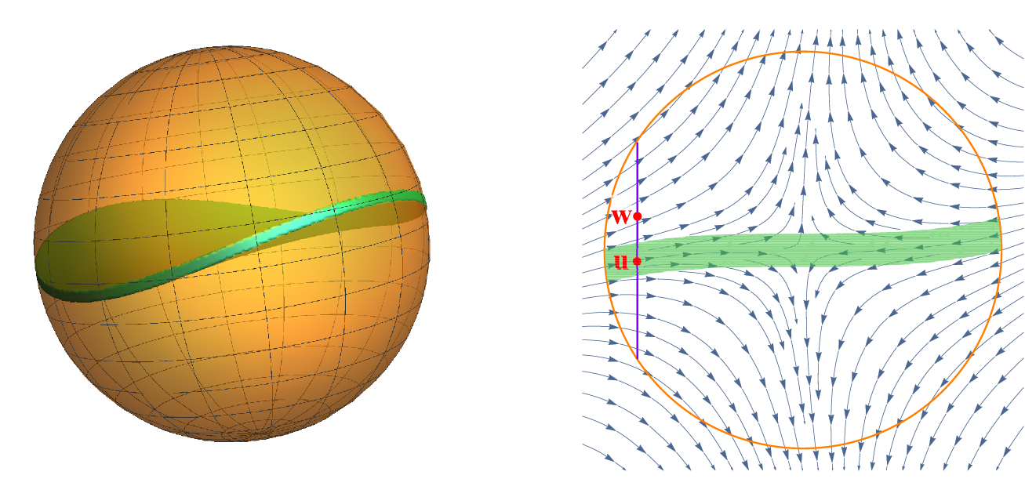
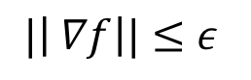
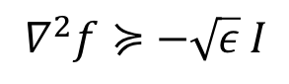
Evading saddle points..
[Ge, Huang, Jin, Yuan’15 ] Add noise to gradient (“perturbed GD”)
(Runtime improvements: Jin et al’17]
Analysis of random walk
Within poly(d/ε) time “escape” all saddle points and achieve “Approx 2nd order minimum”
Min in n-1 dimensions, max in one
$$|\left| ∇f\right||≤ε$$
$$∇^{2}f≽−\sqrt{ε} I$$
(Analyses of probability flow out of “stuck region”)
[NB: perturbed GD with large noise = “Langevin dynamics” in stat. physics)

Slide 13
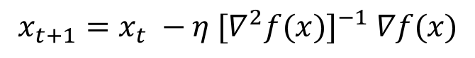
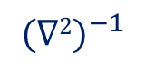
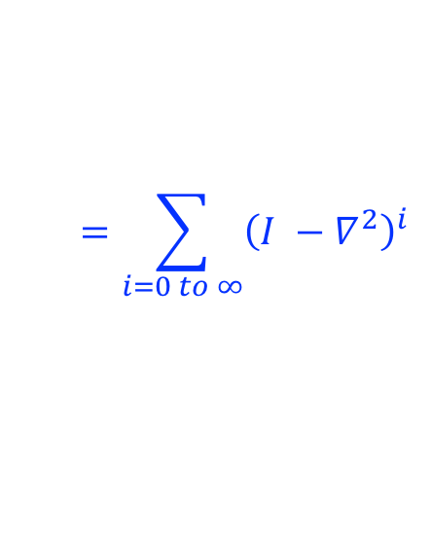
2nd order optimization for deep learning? (Newton method?)
$$x_{t+1}=x_{t} −η {{[∇}^{2}f(x)]}^{−1} ∇f(x)$$
f(𝛉)
More relevant: For any vector v,
Backprop can compute (∇²f)v in linear time. [Pearlmutter’94]
𝛉
f
∇f|_{𝛉}
∇²f|_{𝛉}
[Werbos’74]
Can do approximate 2nd order optimization asymptotically faster than 1st order! (empirically, slightly slower) [Agarwal et al’17, Carmon et al’17]
Idea:
$$=\sum_{i=0 to ∞}{{\left(I −∇^{2}\right)}^{i}}$$
(but use finite truncation)
$${(∇2)}^{−1}$$
But 2nd order doesn’t seem to find better quality nets so far.

Slide 14
Non-black box analyses
Various ML problems that’re subcases of depth 2 nets (i.e., one hidden layer between input and output).
Often make assumptions about the net’s structure, data distribution, etc. (landscape is mathematically known) s
May use different algorithm (eg, tensor decomposition, alternating minimization, convex optimization …) than GD/SGD.
Topic modeling [A., Ge, Moitra’12] [A. et al’13] Sparse coding [A., Ge, Ma, Moitra’14, ‘15] [Anandkumar et al’14] Phase retrieval [Candes et al’15] Matrix completion [Many papers, eg Jain et al.’13] Matrix sensing Learning Noisy Or nets [A., Ge, Ma’17]

Slide 15
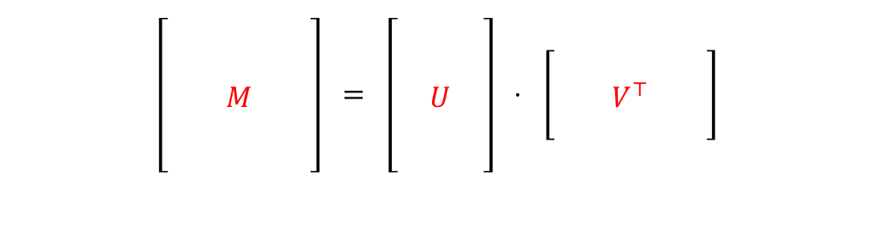
Convergence to global optimum from arbitrary initial point ( via understanding the landscape)
Matrix completion
$$\left[\begin{aligned} \\ \\ \\ \\ \end{aligned}\begin{aligned} \\ \\ \\ \\ \end{aligned}\begin{aligned} \\ \\ M \\ \\ \end{aligned}\begin{aligned} \\ \\ \\ \\ \end{aligned}\begin{aligned} \\ \\ \\ \\ \end{aligned}\right] = \left[\begin{aligned} \\ \\ \\ \\ \end{aligned}\begin{aligned} \\ \\ U \\ \\ \end{aligned}\begin{aligned} \\ \\ \\ \\ \end{aligned}\right] ⋅ \left[\begin{aligned} \\ \\ \end{aligned}\begin{aligned} \\ \\ \end{aligned}\begin{aligned} \\ V^{⊤} \\ \end{aligned}\begin{aligned} \\ \\ \end{aligned}\begin{aligned} \\ \\ \end{aligned}\right]$$
Given O(nr) random entries of an nxn matrix M of rank r, predict missing entries.
Subcase of learning depth 2 nets
Feeding1-hot inputs into unknown net; seeting output at one random output node. Learn the net!
V
U
i
[Ge, Lee, Ma’17] All local minima are global minima. So perturbed GD finds global minimum from arbitrary initial point. (proof is fairly nontrivial)
0000001000

Slide 16

Any theorems about learning multilayer nets?
Yes, but usually only for linear nets (i.e., hidden nodes compute f(x) = x).
Overall net = product of matrix transformation = itself a linear transformation
But optimization landscape still holds surprises…
Some papers: [Baldi, Hornik’88], [Saxe et al ‘13] (dynamics of training) [Kawaguchi’16] [Hardt and Ma’16] (landscape of linear resnets);
[A., Cohen, Hazan’18]

Slide 17
Some other optimization ideas I did not cover (some are only semi-theorems)
Budding connections with “physics” ideas: natural gradient, Lagrangian method, ..
Adversarial examples and efforts to combat them
Optimization for unsupervised learning (esp. probabilistic models), reinforcement learning.
Information-theoretic interpretation of training algorithms, eg “information bottleneck”

Slide 18
Part 3: Overparametrization and Generalization theory
e.g., Why is it a good idea to train VGG19 (20M parameters) on CIFAR10 (50K samples)? No overfitting?

Slide 19
Overparametrization may help optimization : folklore experiment e.g [Livni et al’14]
Generate labeled data by
feeding random input vectors
Into depth 2 net with
hidden layer of size n
Difficult to train a new net using this labeled data
with same # of hidden nodes
Still no theorem explaining this…
Much easier to train a new net with bigger hidden layer!
Notes:
Notes: Use consistent number like “100” to describe # of hidden nodes

Slide 20
But textbooks warn us: Large models can “Overfit”
Generali-zation error
Real Life Deep learning
Longtime belief: SGD + regularization eliminates “excess capacity” of the net
Notes:
Should change graphic to show zero training error?

Slide 21
But, excess capacity is still there!
Inception v3 net on CIFAR10
Hope: An explanation will also identify intrinsic structure of a “well-trained” net.
[Understanding deep learning requires rethinking generalization, Zhang et al. 17]
Notes:
Don’t forget to explain 2nd figure!

Slide 22
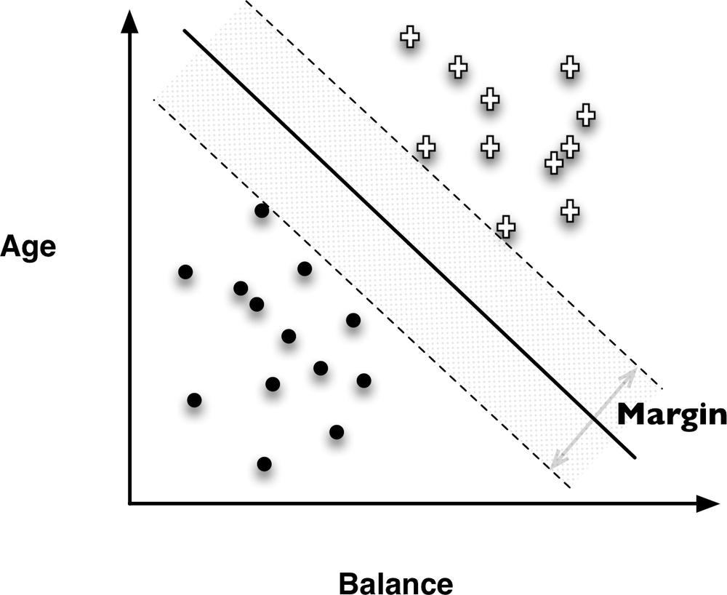
BTW: Excess capacity phenomenon exists in linear models!
γ = margin
Classifier has d parameters.
Quantify effective capacity of deep nets??
If has margin γ , then possible to learn it with < O(log d)/γ² datapoints! (low effective capacity!)
But always possible to fit linear classifier to d-1 randomly labeled datapoints as well.
See also [Understanding deep learning requires understanding kernel learning. Belkin et al’18]
Notes:
Mention: jiggle classifier a lot; unchanged…

Slide 23

Effective Capacity
Roughly, log (# distinct a priori models)
(Rough Analogy: If a system exhibits 2^{k} distinct states we say it has k bits of memory. )
Generalization
Theory (Main Thm)
m = # training samples. N = effective capacity
Usual upperbounds on N: # of parameters, VC dimension, Rademacher
For deep nets, all of these are about the same (usually vacuous)

Slide 24
Proof Sketch
Fix deep net 𝛉 and its parameters Err_{𝛉} = test error
Take iid sample S of m datapoints, Err_{𝛉,S} = avg error on S = training error
By concentration bounds, for fixed net 𝛉 Pr_{S}[diff. between them ≤𝝴] > 1- exp(- 𝝴²m)
“Effective capacity”
= log W, = N
Complication: Net depends upon training sample S
Solution: Union bound over “all possible” 𝛉. If # (possible 𝛉) = W, suffices to let m > (log W)/𝝴²

Slide 25
Old notion: Flat Minima [Hochreiter, Schmidhuber’95]
[Hinton-Camp’93]
Multiple arguments ➜ “Noise in SGD favors flat minima”
“Flat minima” generalize better empirically [Keskar et all’16]
Flat
Sharp
Flat minimum has lower description length ➔ Fewer # of “possible models” with such small descriptions
Makes intuitive sense but hard to make quantitative… (and false for some defns of “sharp” [Dinh et al’17])

Slide 26
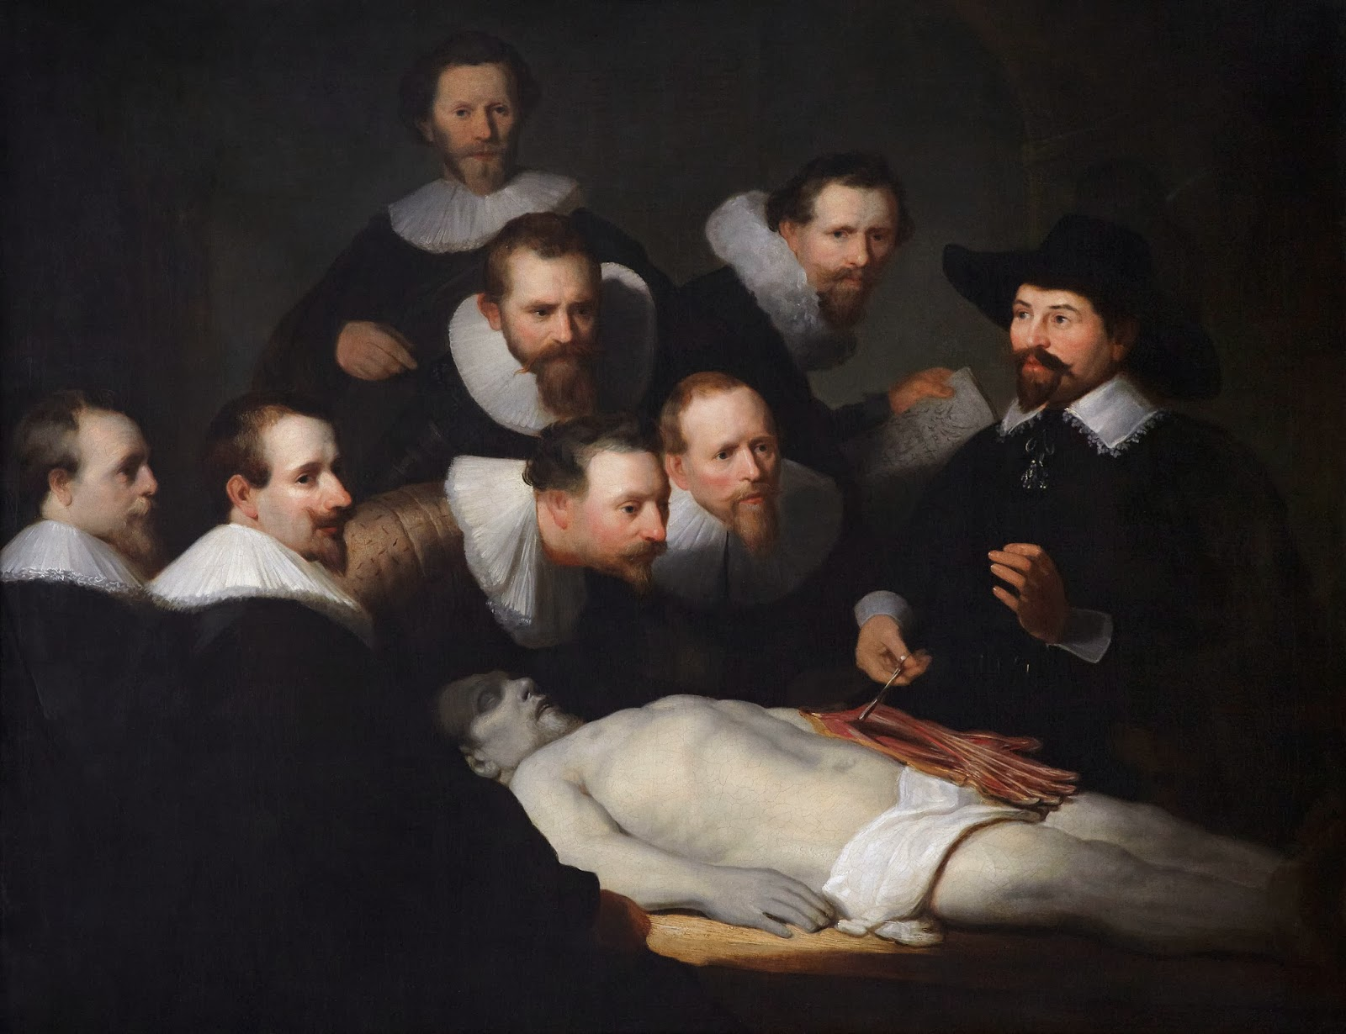
Current status of generalization theory: postmortem analysis…
It has Property 𝚽 shared by very few nets…
TRAINED NET 𝛉
Generalization error
Qualitative check: Correlates with generalization?
𝚽
Quantitative: Use property 𝚽 to compute upper bound on “very few”
and hence effective capacity (much harder!)

Slide 27
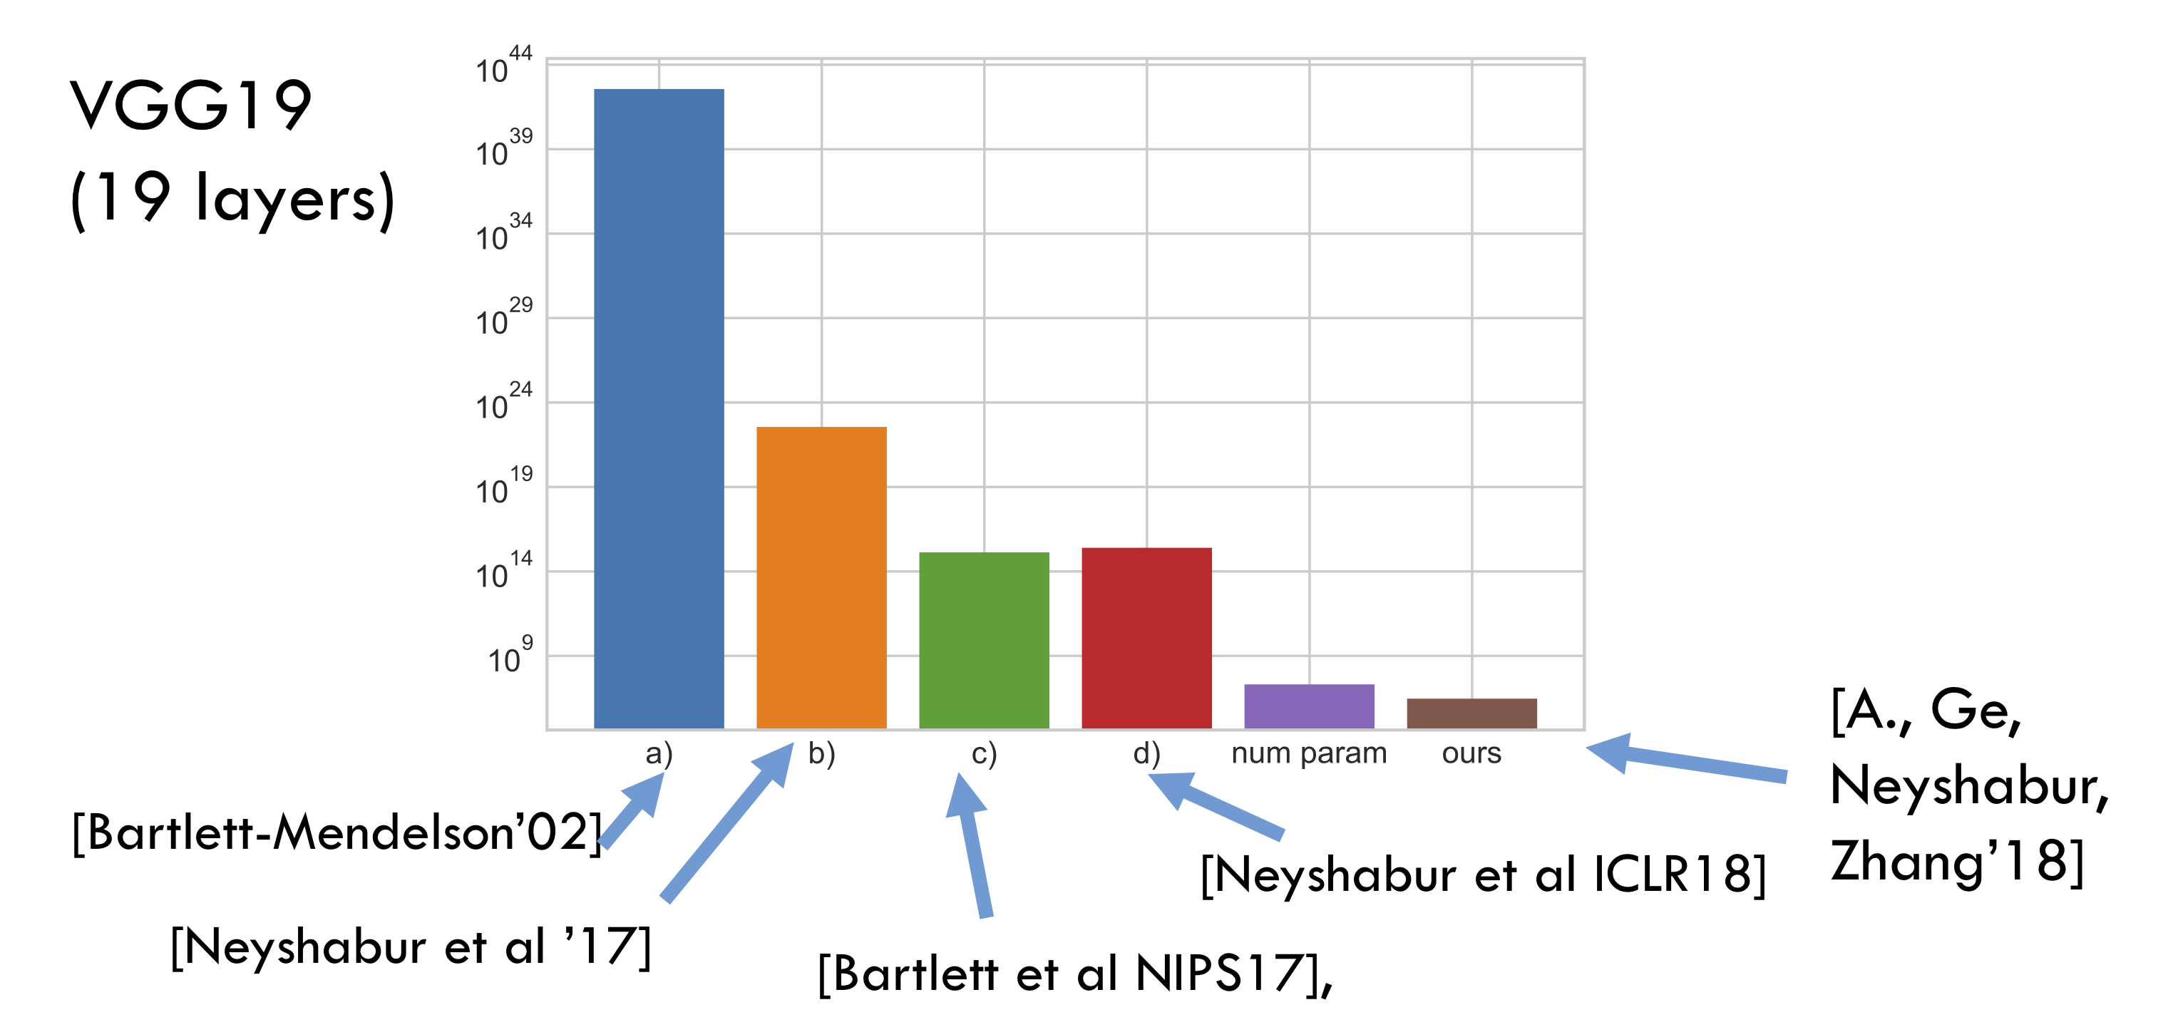
Nonvacuous estimate of “true capacity” has proved elusive (starting point [Langfod-Caruana02]
Ideas include: PAC-Bayes, Margin, Rademacher, .. [Dziugaite-Roy’17] have more nonvacuous bounds for MNIST** but not an asymptotic “complexity measure”

Slide 28
Nonvacuous bound on “true parameters” has proved elusive..
Main idea: Using noise stability to
bound effective
Capacity.

Slide 29

Noise stability for deep nets (can be seen as a “margin” notion for deep nets)
[A., Ge, Neyshabur, Zhang ICML’18]
Noise injection: Add gaussian 𝜂 to output x of a layer (|𝜂| = |x| ) Measure change in higher layers. (If small, then net is noise stable.)

Slide 30
Noise stability of VGG19
[A., Ge, Neyshabur, Zhang ICML’18]
How injected gaussian noise gets attenuated as it passes through to higher layers. (Each layer fairly stable to noise introduced at lower layers!)
Related to other noise stability phenomena independently discovered in experiments of [Morcos et al ICLR’18]

Slide 31
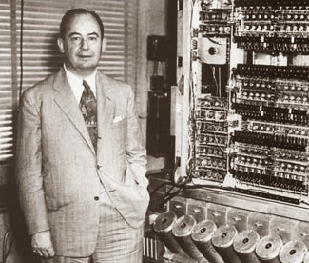
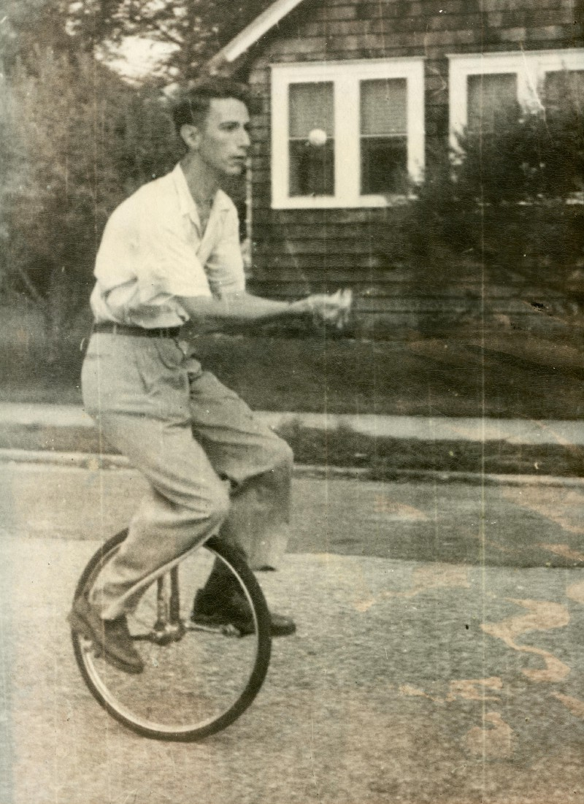
Von Neumann, J. (1956).
Probabilistic logics and the synthesis of reliable organisms from unreliable components.
“Reliable machines and unreliable components…
We have, in human and animal brains, examples of very large and relatively reliable systems constructed from individual components, the neurons, which would appear to be anything but reliable.
…
In communication theory this can be done by properly introduced redundancy.”
Shannon, C. E. (1958).
Von Neumann’s contributions to automata theory.

Slide 32
Understanding noise stability for one layer (no nonlinearity)
η : Gaussian noise
x
Mx
|Mx|/|x| ≫ |M η|/|η|
x + η
M(x + η)
≥
=
Layer Cushion = ratio (roughly speaking..)
Distribution of singular values in a filter of layer 10 of VGG19. Such matrices are compressible…
Notes:
(\sum_i \sigma_i(M)^2)^{1/2}/\sqrt{n}
\sigma_{max}(M)

Slide 33
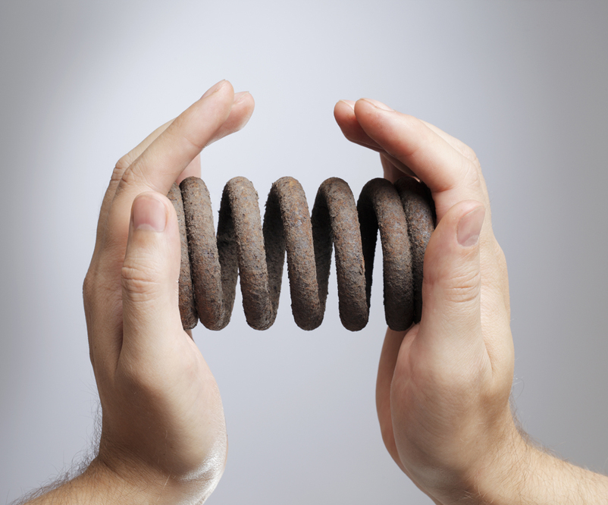
Overview of compression-based method for generalization bounds [A.,Ge, Neyshabur, Zhang’18]; user-friendly version of PAC-Bayes
# parameters ≪ # datapoints
# parameters ≫ # datapoints
Important: compression method allowed to use any number of new random bits, provided they don’t depend on data.

Slide 34
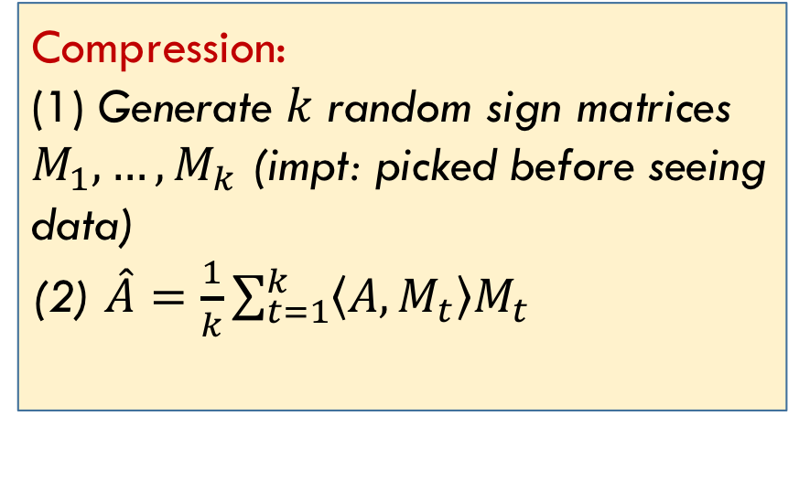
Proof sketch : Noise stability ➔ deep net compressible with minimal change to training error
Idea 1: Compress a layer (randomized; errors introduced are “Gaussian like”)
Idea 2: Errors attenuate as they go through network, as noted earlier.
Compression:
(1) Generate $k$ random sign matrices $M_{1},…,M_{k}$ (impt: picked before seeing data) (2) $\hat{A}=\frac{1}{k}\sum_{t=1}^{k}{\left\langle A,M_{t}\right\rangle M_{t}}$
(Nontrivial extension to convolutional nets)

Slide 35
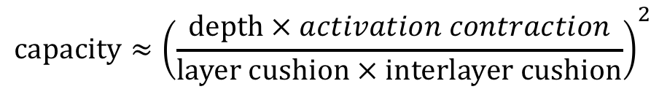
The Quantitative Bound
$$\text{capacity}≈{\left(\frac{\text{depth} × activation contraction}{\text{layer} \text{cushion} × \text{inter}\text{layer} \text{cushion}}\right)}^{2}$$
#param

Slide 36
Correlation with Generalization (qualitative check)
Layer cushion much higher when trained on normal data
than on corrupted data
Evolution during training on normal data..

Slide 37
Concluding thoughts on generalization
Some progress, but final story still to be written.
I don’t ultimately know why trained nets are noise stable.
Quantitative bounds too weak to explain why net with 20M parameters generalizes with 50k training datapoints.
NB: Argument needs to involve more properties of training algorithm and/or data distribution. ([Gunasekar et al’18] Quantify “Implicit bias” of gradient descent towards “low capacity” models in simple settings.)

Slide 38

COMING UP:ROLE of DEPTH; THEORY FOR UNSUPERVISED LEARNING (GANS, TEXT EMBEDDINGS, ..)

Slide 39
Part 3: Role of depth
Ultimate hope: theory informs what architectures are “best” for a given task.

Slide 40
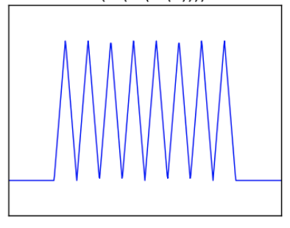
An old question: Role of depth?
Ideal result: exhibit natural learning problem which cannot be done using depth d but can be done with depth d+1
Currently, not within reach of theory, lacking mathematical
formalization of “natural” learning problem…
[Eldan-Shamir’16], [Telgarsky’17]: Such results for less natural problems
Sketch: (i) Characterize max. # of “oscillations” in function computed by depth d net of some size
(ii) Show depth d+1 can compute function with more oscillations .
Notes:
Picture of oscillations..

Slide 41
So does more depth help or hurt in deep learning?
Pros: Better expressiveness (as we just saw)
Cons: More difficult optimization (“vanishing/exploding gradients” unless use special architectures like resnets..)
[A., Cohen, Hazan ICML’18] Increasing depth can sometimes “accelerate” the optimization (including for classic convex problems…)

Slide 42
Acceleration by increasing depth: Simple example [A., Cohen, Hazan ICML’18]
l_{p} regression.
Replace with depth-2 linear circuit
Replace vector w by vector w₁ multiplied by scalar w₂ (overparametrize!)
GD now amounts to
Adaptive learning rate + “memory” of past gradients!

Slide 43
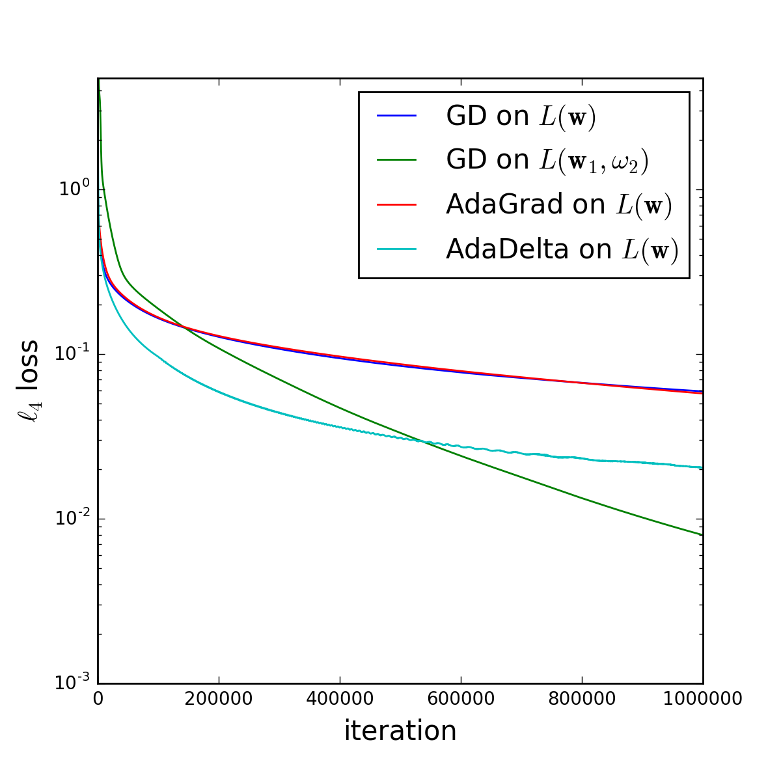
Overparametrization acceleration effect
(UCI regression task…)
l_{p} regression, p=4
Similar effects observed in nonlinear deep net; eg replace fully connected layer by two layers.
Some theoretical analysis for multilayer linear nets.
Proof that acceleration effect due to increase of depth not obtainable via any regularizer on original architecture.

Slide 44
Part 4: Theory for Generative Models and Generative Adversarial Nets (GANs)

Slide 45
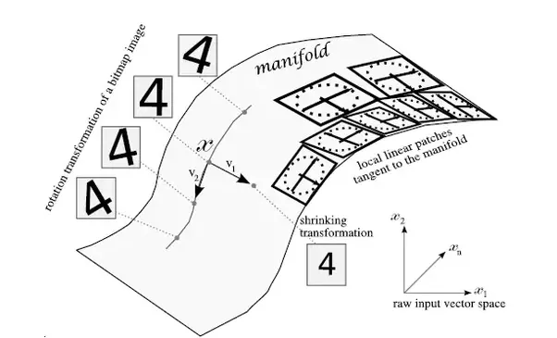
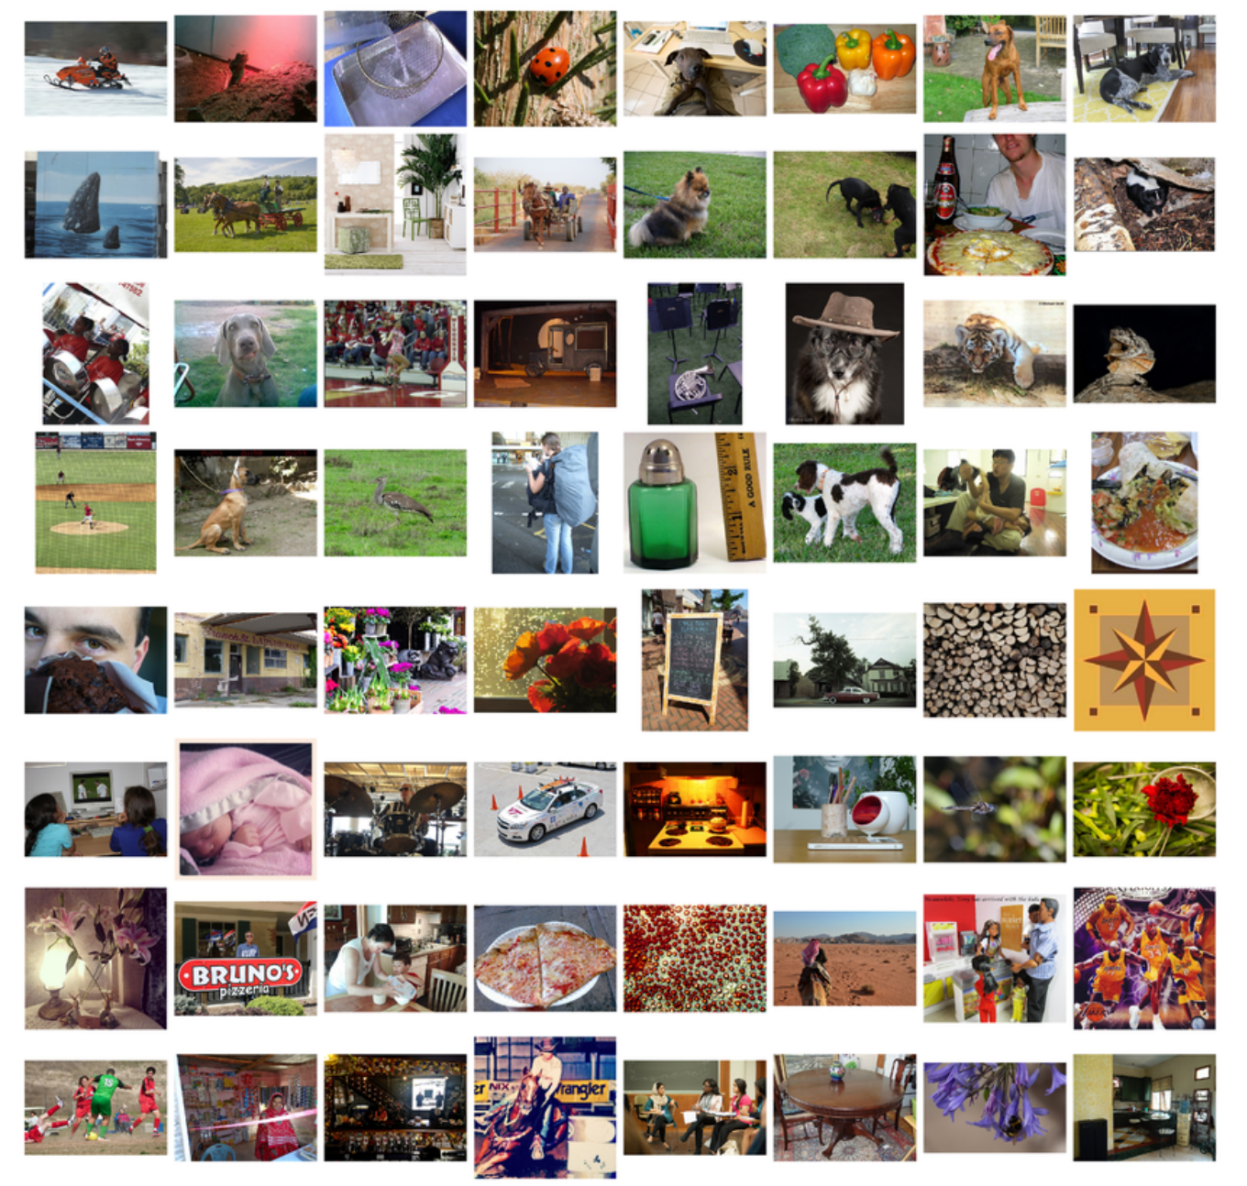
Unsupervised learning motivation: “Manifold assumption”
Goal: Using large unlabeled dataset learn the Image ➔ Code mapping
X : Image
Z: Its ”code” on manifold
Typically modeled as learning the joint prob. density p(X, Z) (Code of X = sample from Z|X)

Slide 46
Unsupervised learning Motivation: “Manifold assumption” (contd)
X : Image
Hope: Code Z (= “High level Representation”)
is good substitute for Image X in downstream classification tasks. (ie solving those tasks requires fewer labeled samples if use Z instead of X)
Z: Its ”code” on manifold
Typically modeled as learning the joint prob. density p(X, Z) (Code of X = sample from Z|X)

Slide 47
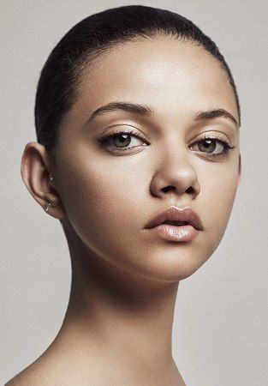

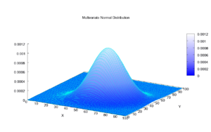
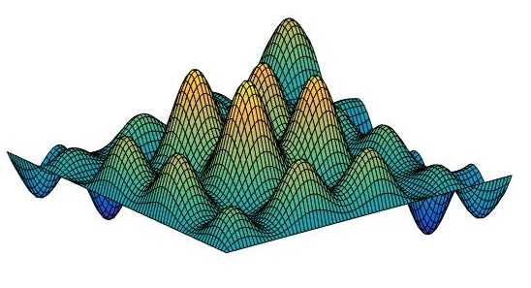
Deep generative models (e.g., Variational AutoEncoders)
Usual training: Max E_{x}[log p(x)]
(“log likelihood”)
Code Z
Image X
D_{real}
N(O, I)
Implicit assumption: D_{real} generatable by deep net of reasonable size.

Slide 48
Generative Adversarial Nets (GANs) [Goodfellow et al. 2014]
Motivations : (1) Avoid loglikelihood objective; it favors outputting fuzzy images.
(2) Instead of loglikelihood, use power of discriminative deep learning to improve the generative model.

Slide 49
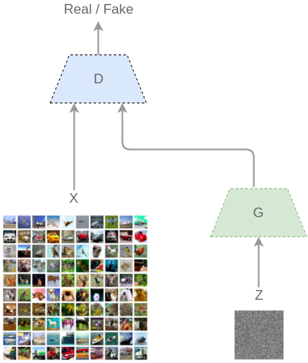
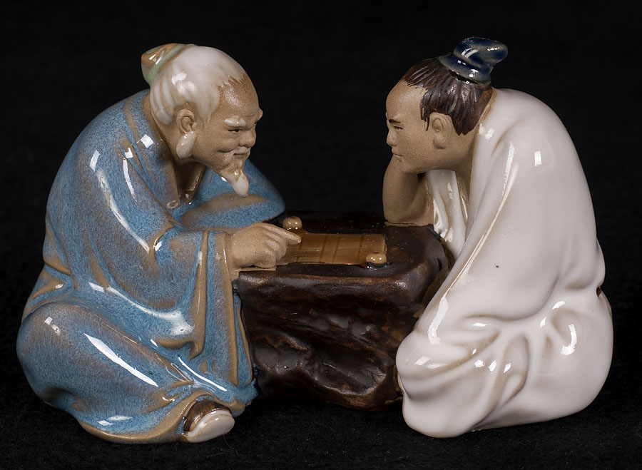
Generative Adversarial Nets (GANs) [Goodfellow et al. 2014]
“Difference in expected output on real vs synthetic images” Wasserstein GAN [Arjovsky et al’17] **
Real (1) or Fake (0)
Discriminator trained to output 1 on real inputs, and 0 on synthetic inputs.
Generator trained to produce synthetic outputs that make discriminator output high values.
D_{v}
D_{synth}
D_{real}
G_{u}
h
[Excellent resource: [Goodfellow’s survey]
u= trainable parameters of Generator net
v = trainable parameters of Discriminator net

Slide 50

Generative Adversarial Nets (GANs) [Goodfellow et al. 2014]
Real (1) or Fake (0)
Discriminator trained to output 1 on real inputs, and 0 on synthetic inputs.
Generator trained to produce synthetic outputs that make discriminator output high values.
D_{v}
D_{synth}
D_{real}
G_{u}
h
Generator “wins” if objective ≈ 0 and further training of discriminator doesn’t help. (“Equilibrium.”)
u= trainable parameters of Generator
v = trainable parameters of Discriminator

Slide 51
What spoils a GANs trainer’s day: Mode Collapse
Since discriminator only learns from a few samples, it may be unable to teach generator to produce distribution D_{synth} with sufficiently large diversity
(many ad hoc qualitative checks for mode collapse..)
New Insight from theory: problem not with # of training samples, but size (capacity) of the discriminator!

Slide 52
Thm [A., Ge, Liang, Ma, Zhang ICML’17] : If discriminator size = N, then ∃ generator that generates a distribution supported on O(Nlog N) images, and still wins against all possible discriminators. (tweaking objectives or increasing training set doesn’t help..)
(NB: D_{real} presumably has infinite support..)
→ Small discriminators inherently incapable of detecting “mode collapse.”
Pf sketch: Consider generator that learns to produce O(N logN) random real images. Consider “all possible discriminators of size N” (suffices to consider “𝛆-net” ). Use concentration bounds to argue that none of them can distinguish D_{real} from this low-support distribution.

Slide 53
How to check support size of generator’s distribution??
Theory suggests GANs training objective not guaranteed to avoid mode-collapse.
Does this happen during real life training???

Slide 54
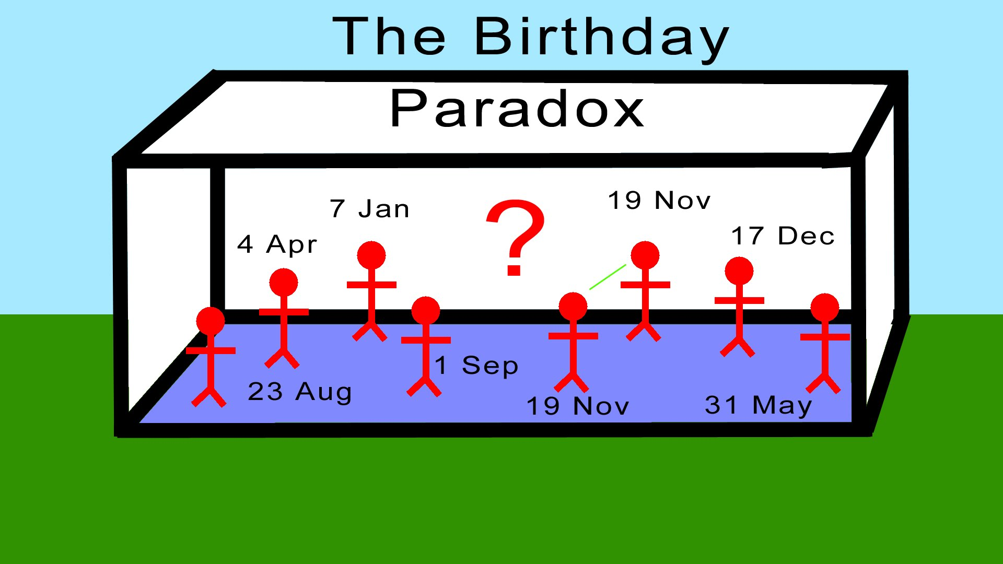
Empirically detecting mode collapse (Birthday Paradox Test) (A, Risteski, Zhang ICLR’18)
If you put 23 random people in a room, chance is > 1/2 that two of them share a birthday.
Suppose a distribution is supported on N images.
Then Pr[sample of size √N has a duplicate image] > ½.
Birthday paradox test* [A, Risteski, Zhang] : If a sample of size s has near-duplicate
images with prob. > 1/2, then distribution has only s² distinct images.
Implementation: Draw sample of size s; use heuristic method to flag possible near-duplicates. Rely on human in the loop verify duplicates.

Slide 55
Estimated support size from well-known GANs
DC-GAN [Radford et al’15]: Duplicates in 500 samples. Support size (500)² = 250K
BiGAN [Donohue et al’17] and ALI (Dumoulin et al’17]: Support size = (1000)² = 1M
CelebA (faces):
200k training images
(Similar results on CIFAR10)
Followup: [Santurkar et al’17] Different test of diversity; confirms lack of diversity.

Slide 56
Part 4.1 (brief): Need to rethink unsupervised learning.
AKA “Representation Learning.”

Slide 57
Unsupervised learning Motivation: “Manifold assumption” (contd)
Hope: Code Z is good substitute for Image X in downstream classification tasks. (ie solving those tasks requires fewer labeled samples if have the code)
X : Image
Z: Its ”code” on manifold
“Semisupervised learning??”
Typically modeled as learning the joint prob. density p(X, Z) (Code of X = sample from Z|X)

Slide 58
Caveat : Posssible hole in this whole story that I’m unable to resolve
X : Image
For Z to be good substitute for image X in downstream classification, density p(X,Z) needs to be learnt to very high numerical accuracy.
[See calculation in blog post by A. + Risteski’17, www.offconvex.org]
Z: Its ”code” on manifold
Joint Density p(X,Z)
Doesn’t mean unsupervised learning can’t happen, just that
usual story doesn’t justify it.

Slide 59
Food for thought…
Maximizing log likelihood (presumably approximately)
may lead to little usable insight into the data.
How to define utility of GANs (if not as distribution learners)?
Need to define unsupervised learning using a “utility” approach (What downstream tasks are we interested in and what info do they need about X?)
(Similar musings on INFERENCE blog, April’18. e.g., What would a “representation learning competition” look like?)

Slide 60
Part 5: Deep Learning-free text embeddings (illustration of above principles)
“Hand-crafted with love and care….”
Black box that’s end-to-end differentiable…

Slide 61
Two sentences that humans find quite similar
A lion rules the jungle.
The tiger hunts in this forest.
NB: No words in common!
How to capture similarity and other properties of pieces of text?

Slide 62
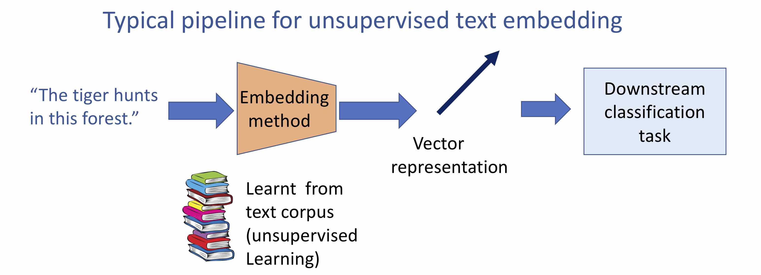
Obvious inspiration: Word embeddings (word2vec, GloVe etc.) Usual method: Recurrent neural net, LSTM (Long Short Term Memory), etc.
[Le,Mikolov’14] Paragraph vectors [Kiros et al’15]: SkipThought.
Much followup work including fastrer training/inference, or incorporating supervision (eg InferSent [Conneau et al’17]).

Slide 63
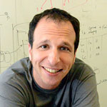
Learnt using LSTMs…
Ben Recht Linearization Principle: “Before committing to deep model figure out what the linear methods can do….”

Slide 64
Cottage industry of text embeddings that’re linear
“Word embeddings + linear algebra”
Simplest: Sum of word embeddings of constituent words (Inspired by word2vec_{CBOW} )
(Wieting et al ‘16) Weighted sum; weights learnt via fit to paraphrase dataset. (“semi-supervised”) [A,Liang,Ma ‘17] “SIF” Smooth inverse weighted sum, followed by denoising using top singular vector….

Slide 65
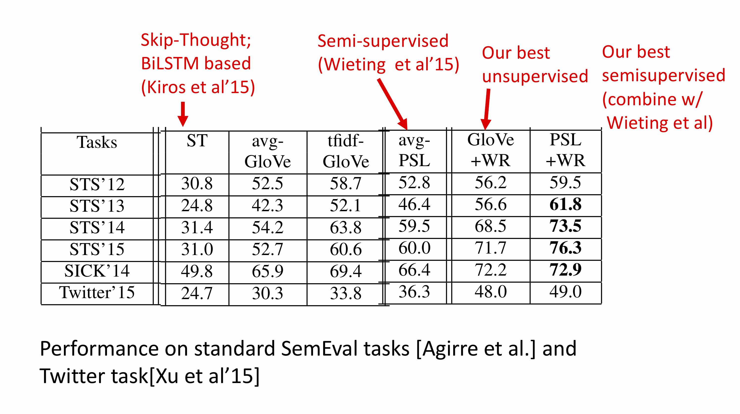
Performance (similarity/entailment tasks)
SIF
(For theory behind SIF embedding see original paper…)

Slide 66
Important: Classifier should be simple (eg linear!)
Downstream task not known ahead of time! Perhaps embedding must capture all/most of the information in text? (e.g., Bag-of-Words info)

Slide 67
Word extraction out of linear embeddings ⇔ sparse recovery
Recall sum-of-words embedding:
Recovering Sparse x given Ax ≍ “Compressed Sensing”
(aka “Sparse recovery”)
[Donoho06, Candes-Romberg-Tao06]
x
0
0
0
1
0
0
0
1
1
A
v_{w}
Do-able if A satisfies “RIP”/”Random”/”Incoherence”. (unfortunately none are satisfied by matrix of GloVe embeddings..)
w
Columns of A = Word embeddings
Bag-of-word vector

Slide 68
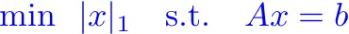
(Bag-of-Words only)
Recovery algorithm: Basis Pursuit
Recovered BoW
Embedding
Ability to recover original words doesn’t imply the embedding is good for classification via linear classifier….
[Rademacher = random +1/-1
Notes:
\mbox{min}~~|x|_1 \quad \mbox{s.t.}\quad Ax = b

Slide 69
Recovery algorithm: Basis Pursuit
But Calderbank et al ‘09 showed linear classification
on compressed vector Ax is essentially as good as x. ➔ Not surprising linear embeddings work well in downstream tasks! (Even provably so, under some compressed sensing type conditions.)
Notes:
\mbox{min}~~|x|_1 \quad \mbox{s.t.}\quad Ax = b

Slide 70
More powerful linear embeddings
[Some inspiration from
[Plate 95] [Kanerva’09]
Distributed Co-occurrence (DisC) Embeddings [A, Khodak, Saunshi, Vodrahalli ICLR’18]
Use “Compressed sensing” of n-gram information (bi-gram = word pairs, tri-gram = word triples..) Vector for bigram (w,w’) = v_{w} ⊙ v_{w’} (entrywise product)
A La Carte Sentence Embeddings [Khodak, Saunshi, Liang, Ma, Stewart, A. ACL’18]
Modify DisC by using “induced n-gram embeddings”, created using linear regression. (Induced embeddings useful in other NLP tasks too!)

Slide 71
Comparison with state-of-the art text embeddings on suite of downstream classification tasks
Bag of n-gram
➜
Logeswaran and Lee 2018
Open: Hand-crafted analogs of “Attention” and “Character-level LSTMs”?

Slide 72
Aside: Another illustration of Linearization principle in RL [Mania,Guy,Recht’18]
Linear Quadratic Regulator (old model from control theory) plus simple Random Search beats state of the art deepRL on some standard RL tasks
See Recht’s talk

Slide 73
Wrapping up…

Slide 74
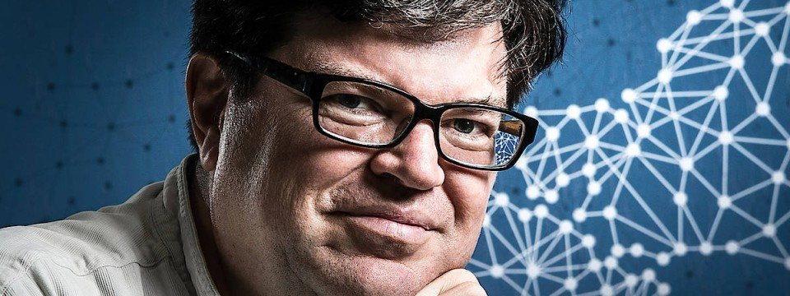
What to work on (suggestions for theorists)
Use Physics/PDE insights, such as calculus of variations (Lagrangians, Hamiltonians, etc.)
Look at unsupervised learning (Yes, everything is NP-hard and new but that’s how theory grows.)
Theory for Deep Reinforcement learning. (Currently very little.)
Going beyond 3), design interesting models for interactive learning (of language, skills, etc.). Both theory and applied work here seems to be missing some basic idea. (Theory focuses on simple settings like linear classifiers/clustering.)
“The revolution will not be supervised.”

Slide 75
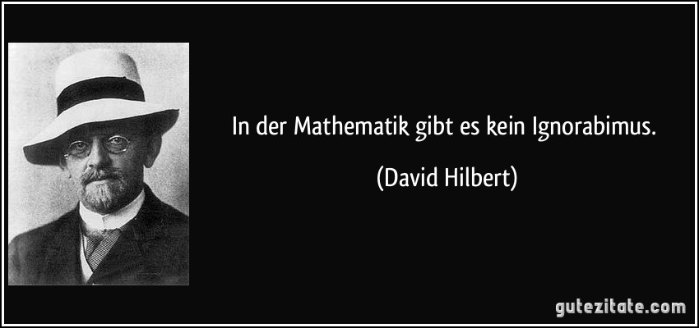
Concluding thoughts
Deep learning is a new frontier for theory; many new avenues.
Best theory will emerge from engaging with real data and real deep net training. (Nonconvexity and attendant complexity seems to make armchair theory less fruitful.)
I am optimistic that deep learning methods can be understood and simplified.
THANK YOU!!
In der Mathematik gibt es kein ignorabimus D. Hilbert

Slide 76

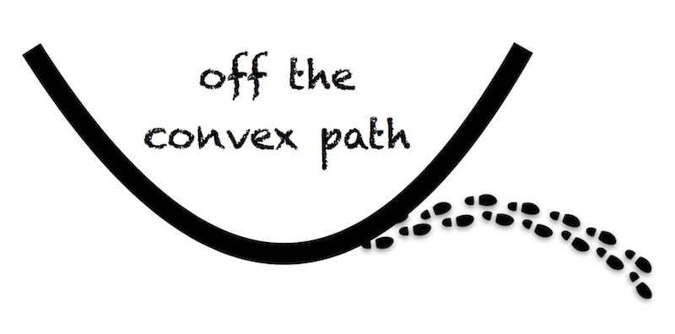
Advertisements
http://unsupervised.cs.princeton.edu/deeplearningtutorial.html
Come join special year at Institute for Advanced Study 2019-20 http://www.math.ias.edu/sp/
Resources: www.offconvex.org
Grad seminar (hope to put all notes online soon) http://www.cs.princeton.edu/courses/archive/fall17/cos597A/

Slide 77
Extra slides..

Slide 78
Convergence to global optimum: Measure of progress
Trying to reach global optimum z*
update: z^{s+1} = z^{s} – η g^{s}
Need NOT be gradient!
Also, starting point special
Show: direction -g^{s} is substantially correlated with best direction one could take, namely, z^{s} – z*
Definition: g^{s} is (α, β, ε_{s})-correlated with z* if for all s:
(“almost-convex”; generalizes several previous progress measures.
Simple proof shows it implies quick convergence.)
Notes:
<g, z^s - z^*\hspace*{-0.05in}> \quad \geq \quad \alpha |z^s - z^*|^2 + \beta |g_s|^2 -\epsilon_s

